Slide 1
MONITOR AND LOG APPLICATION PERFORMANCE
PRESENTING BY:
M.MALESHWARI-22H51A0536
MD.INAYATH-22H51A0541
P.CHANDHANA-22H51A0546

Slide 2
INTRODUCTION:
In modern web development, application performance monitoring is crucial for delivering responsive and user-friendly experiences. As users expect fast-loading pages and seamless interactions, identifying and addressing performance bottlenecks has become a key part of the development process. While robust third-party monitoring tools are available, a lightweight, browser-based solution using HTML and JavaScript provides an accessible alternative, especially useful for small applications or early-stage performance checks.
By utilizing the browser’s built-in Performance API, developers can collect essential metrics like page load time, Time to First Byte (TTFB), and DOM load time, and display them directly in the browser. This approach not only enables real-time client-side monitoring but also offers the flexibility to log data to a backend server for further analysis, making it a practical solution for immediate insights into application performance.

Slide 3
ABSTRACT:
Application performance monitoring is essential for understanding user experience and ensuring optimal application functionality. This paper explores a browser-based approach to monitoring and logging performance metrics by leveraging HTML and JavaScript. Through the implementation of the Performance API and simple DOM manipulation, we collect and display key performance metrics such as page load time, Time to First Byte (TTFB), and DOM load times. This method provides a straightforward solution for developers to gain quick insights into application performance without relying on complex third-party tools. Additionally, this approach can be extended to log metrics to a backend server for centralized monitoring and further analysis. Our findings indicate that HTML and JavaScript offer a viable solution for real-time, client-side performance monitoring, particularly useful for small-scale applications and initial debugging stages.

Slide 4
CODE:
<!DOCTYPE html>
<html lang="en">
<head>
<meta charset="UTF-8">
<meta name="viewport" content="width=device-width, initial-scale=1.0">
<title>Application Performance Monitor</title>
<style>
body { font-family: Arial, sans-serif; }
table { width: 100%; border-collapse: collapse; }
th, td { border: 1px solid #ddd; padding: 8px; text-align: left; }
th { background-color: #f2f2f2; }
</style>
</head>
<body>
<h1>Application Performance Monitor</h1>
<table id="performance-table">
<thead>
<tr>
<th>Metric</th>
<th>Value</th>

Slide 5
</tr>
</thead>
<tbody id="performance-data">
</tbody>
</table>
<script>
function logPerformanceData() {
// Get performance metrics
const performanceData = [
{ metric: "Navigation Start", value: performance.timing.navigationStart },
{ metric: "Load Event Start", value: performance.timing.loadEventStart },
{ metric: "Load Event End", value: performance.timing.loadEventEnd },
{ metric: "DOM Content Loaded Event Start", value: performance.timing.domContentLoadedEventStart },
{ metric: "DOM Content Loaded Event End", value: performance.timing.domContentLoadedEventEnd },
{ metric: "Time to First Byte (TTFB)", value: performance.timing.responseStart - performance.timing.requestStart },
{ metric: "DOM Load Time", value: performance.timing.domComplete - performance.timing.domInteractive },
{ metric: "Page Load Time", value: performance.timing.loadEventEnd - performance.timing.navigationStart }
];

Slide 6
// Log data to HTML table
const performanceTable = document.getElementById("performance-data");
performanceData.forEach(data => {
const row = document.createElement("tr");
const metricCell = document.createElement("td");
const valueCell = document.createElement("td");
metricCell.textContent = data.metric;
valueCell.textContent = data.value + " ms";
row.appendChild(metricCell);
row.appendChild(valueCell);
performanceTable.appendChild(row);
});
// Optional: Log to console for debugging
console.table(performanceData);
} // Run after page has fully loaded
window.addEventListener('load', logPerformanceData);
</script>
</body>
</html>

Slide 7
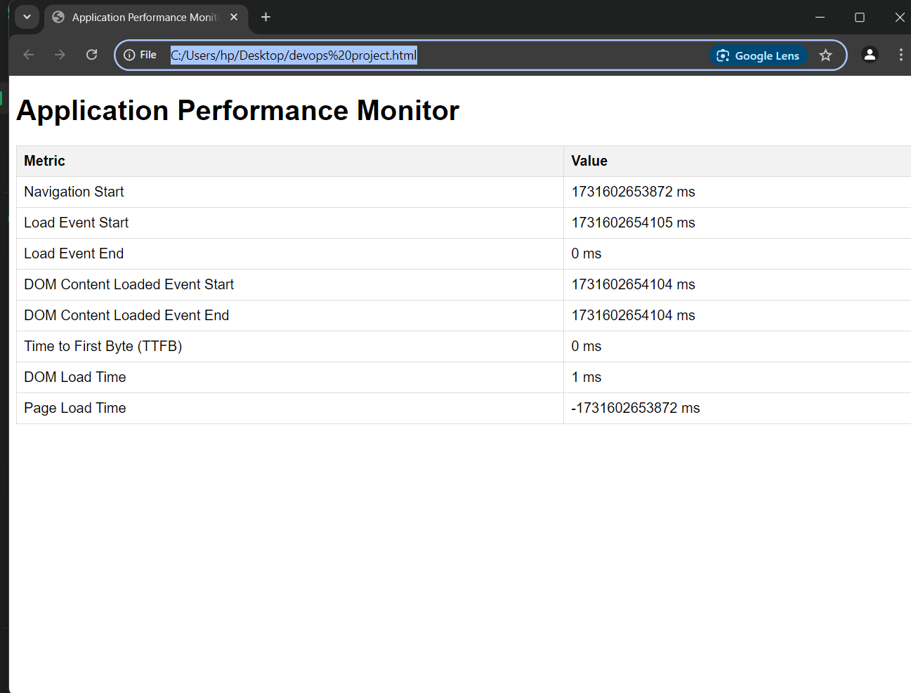
OUTPUT:

Slide 8
CONCLUSION
Monitoring and logging application performance are essential practices for ensuring the reliability, efficiency, and scalability of modern systems. By continuously tracking key performance metrics and capturing detailed logs, organizations can quickly identify and address issues, optimize resource usage, and enhance user experience. Effective performance management enables teams to anticipate problems, reduce downtime, and support ongoing improvements, ultimately aligning application performance with business goals.

Slide 9
THANK YOU

